Slide 1
GUI Controlled LED
Ahmed Krdžalić

Slide 2
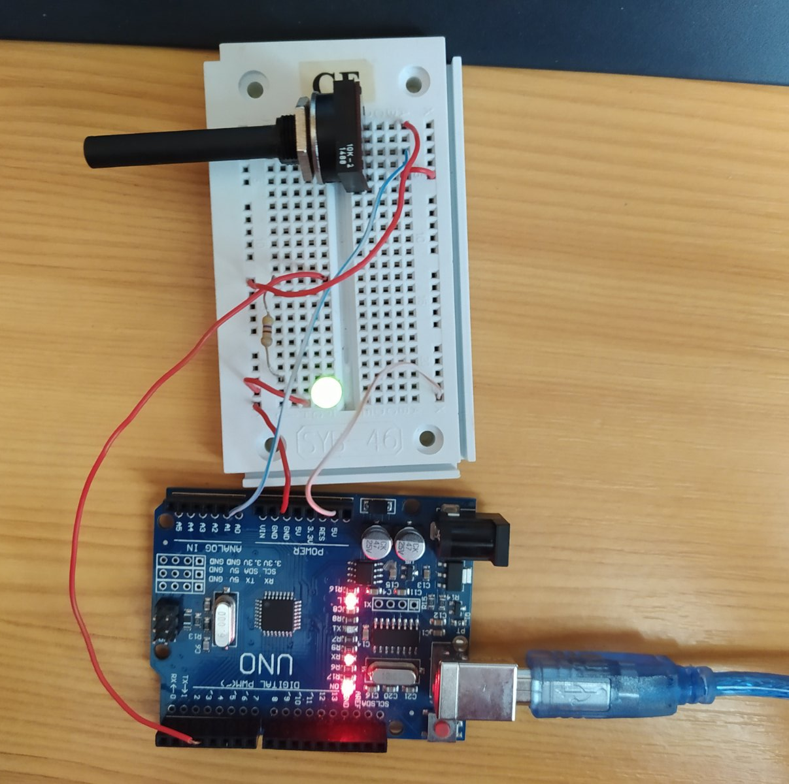
Hardware
LED
Potentiometer
Wiring
Resistor
Arduino UNO
USB cable
board.

Slide 3
Software
1
if(onoff){
if(options == 1){
int val = analogRead(knob);
Serial.println(String(val));
val = map(val, 1, 1024, 1, 255);
analogWrite(led, val);
delay(100);
}
else if(options == 2){
analogWrite(led, 254);
delay(100);
analogWrite(led, 0);
delay(100);
}
else{
analogWrite(led, 254);
delay(1000);
analogWrite(led, 0);
delay(1000);
}
}else{
analogWrite(led, 0);
}
}
Arduino sketch
#define led 3
#define knob A0
char serialData;
bool onoff = false;
int options;
void setup() {
pinMode(led, OUTPUT);
Serial.begin(9600);
options = 1;
}
void loop() {
if(Serial.available() > 0){
serialData = Serial.read();
if(serialData == '1'){
onoff = true;
}
else if(serialData == '0'){
onoff = false;
}
else if(serialData == 'a'){options = 1;}
else if(serialData == 'b'){options = 2;}
else if(serialData == 'c'){options = 3;}
}

Slide 4
Software
arduinoData = serial.Serial('COM7', 9600)
window = Tk()
window.geometry('350x200')
window.title("Project")
btn_on = Button(window, text="ON", bg="green", fg="white", font=("Arial Bold", 15), command=turn_on)
btn_off = Button(window, text="OFF", bg="red", fg="white", font=("Arial Bold", 15), command=turn_off)
btn_o1 = Button(window, text="Potentiometer(1)", bg="orange", fg="black", font=("Arial Bold", 10), command=option_1)
btn_o2 = Button(window, text="Blink Fast(2)", bg="orange", fg="black", font=("Arial Bold", 10), command=option_2)
btn_o3 = Button(window, text="Blink Slow(3)", bg="orange", fg="black", font=("Arial Bold", 10), command=option_3)
lbl_opt = Label(window, text="Choose Option", font=("Arial Bold", 12))
lbl_opt_num = Label(window, text="Active option: None", font=("Arial Bold", 12))
btn_on.place(x=100, y=50)
btn_off.place(x=200, y=50)
btn_o1.place(x=20, y=130)
btn_o2.place(x=140, y=130)
btn_o3.place(x=232, y=130)
lbl_opt.place(x=110, y=100)
lbl_opt_num.place(x=110, y=160)
window.mainloop()
2
Python
import serial
from tkinter import *
def turn_on():
arduinoData.write(b'1')
lbl_change(1)
def turn_off():
arduinoData.write(b'0')
lbl_change(None)
def option_1():
arduinoData.write(b'a')
lbl_change(1)
def option_2():
arduinoData.write(b'b')
lbl_change(2)
def option_3():
arduinoData.write(b'c')
lbl_change(3)
def lbl_change(opt):
lbl_opt_num.config(text="Active option: " + str(opt))

Slide 5
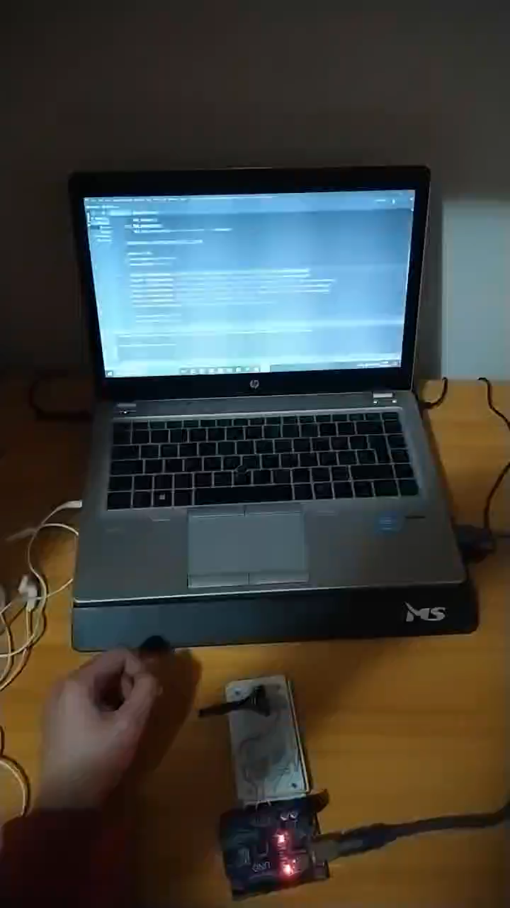
VIDEO
Here is a video that shows that
all features work fine.

Slide 6
Thank You For Your Attention
Notes:
In Slide Show mode, select the arrows to visit links.

